Slide 1
BIBS
MRM Deep Learning Analysis
최정인

Slide 2
INDEX
01 Marker Selection
02 Results compared to Oncotarget

Slide 3
01
Marker Selection
Using ML feature importance

Slide 4
MRM DL 분석
01. Marker Selection
Top 15 Gene Selected based on SHAP value
Peptide | Gene
 | CA19-9
AADDTWEPFASGK | TTR
DYFIATCK | C1R
TLLSNLEEAK | CLU
ASSIIDELFQDR | CLU
VLFYVDSEK | C7
DLLLPQPDLR | LRG1
VAAGAFQGLR | LRG1
VFSLQWGEVK | CFI
LSNNALSGLPQGVFGK | CPN2
TWYPEVPK | C4BPA
LSLEIEQLELQR | C4BPA
ALLAFQESK | ITIH2
NADYSYSVWK | C5
GGSASTWLTAFALR | C5
FQASVATPR | MBL2
EFGNTLEDK | APOC1
EWFSETFQK | APOC1
EPAVLELEGK | CAP1
CMPTFQFFK | TXN
suitable for kit | Sign of beta
O | +
O | --
O | --
O | --
O | CLU
O | +
O | --
O | LRG1
O | +
O | +
O | --
O | C4BPA
X | +
O | +
O | C5
O | +
O | --
O | APOC1
O | --
O | +
Unsuitable for kit
Suitable for kit but negatively correlated
Suitable for kit and
positively correlated
Sign of Correlation was determined by single logistic regression
Notes:
심리학에서 나온 자극-반응의 이론을 토대로,

Slide 5
02
Results compared to Oncotarget

Slide 6
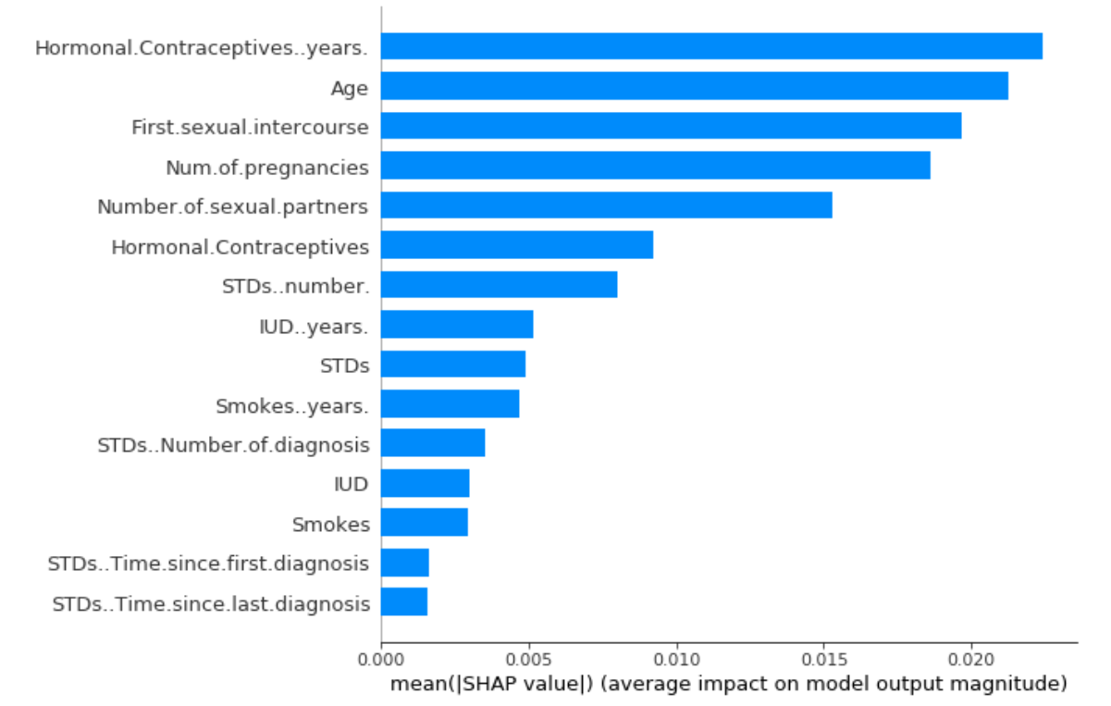
MRM DL 분석
02. Results Compared to Oncotarget
Model | AUC_train | SEN_train | AUC_test1 | AUC_test2 | AUC_test3 | AUC_test4
CA19_9 + LRG1 + TTR | 0.8994 | 0.7806 | 0.8929 | 0.879 | 0.9024 | 0.6941
CA19_9 + C1R + TTR | 0.997 | 0.845 | 0.943 | 0.923 | 0.994 | 0.81
CA19_9 + CFI + C7 | 0.988 | 0.892 | 0.926 | 0.931 | 0.982 | 0.823
CA19_9 + CLU + C7 | 0.982 | 0.872 | 0.932 | 0.91 | 0.98 | 0.892
CA19_9 + C5 + C4BPA | 0.972 | 0.765 | 0.976 | 0.923 | 0.93 | 0.692
CA19_9 + C5 + C7 | 0.97 | 0.902 | 0.893 | 0.896 | 0.902 | 0.729
CA19_9 + C7 + CPN2 | 0.969 | 0.774 | 0.892 | 0.871 | 0.924 | 0.73
CA19_9 + C1R + APOC1 | 0.967 | 0.801 | 0.901 | 0.876 | 0.931 | 0.71
CA19_9 + C5 + APOC1 | 0.956 | 0.891 | 0.95 | 0.891 | 0.941 | 0.692
CA19_9 + C1R + LRG1 | 0.954 | 0.852 | 0.872 | 0.791 | 0.892 | 0.824
CA19_9 + C7 + TTR | 0.952 | 0.91 | 0.943 | 0.933 | 0.843 | 0.805
Sign of Beta를 고려하지 않고 분석을 진행한 결과
14C3의 경우의 수 중 train AUC가 큰 순으로 Top 10개의 tripple marker 조합 선정
Oncotarget 논문에서 언급된 CA19_9 + LRG1 + TTR, SVM 방법보다 좋은 triple-panel 3개 존재.
Positively correlated된 peptide만 사용한 결과 중 논문보다 좋은 triple-panel 1개 존재
&
Notes:
심리학에서 나온 자극-반응의 이론을 토대로,

